Slide 1
Third Presentation: BS Final year project
OPTICAL PROPERTIES OF ACTIVE AND PASSIVE PHOTONIC RESONATORS
Ahmad Bilal
Supervisor
Dr. Ahmer Naweed

Slide 2
Introduction
An optical resonator is a device that confines light within small volumes.
They exhibits resonant behavior naturally at some particular frequencies known as resonant frequencies.
They can be used to filter out some specific frequencies of the incoming signal.
The condition for resonance in a resonator is that the round trip distance, 2d , is equal to an integer number of wavelengths λ of the wave:
  Where N is an integer 1, 2, 3 ….
2d = Nλ
Illustration of a basic optical cavity with standing waves
d

Slide 3
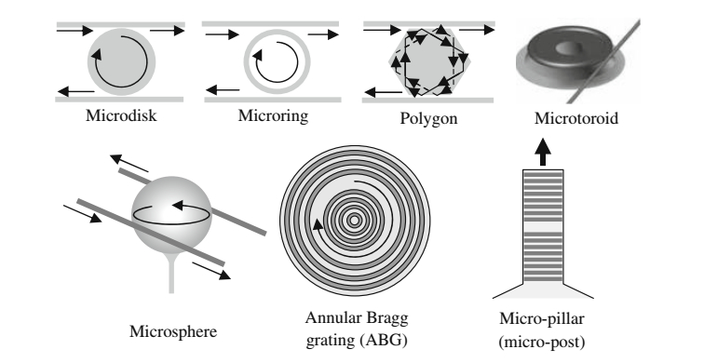
Various Versions of Optical Resonators
[1] K. Vahalla, “Optical microcavities,” Nature 2003

Slide 4
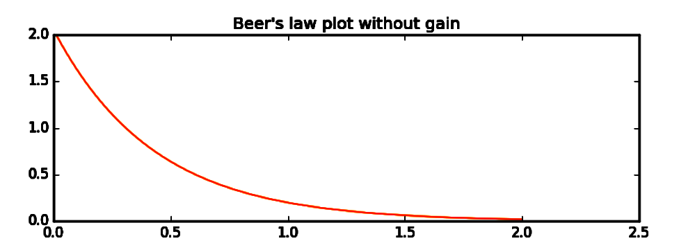
Light Propagation Through an Absorbing Medium
When Electromagnetic waves travel through an absorbing medium, they experience attenuation which can be explained by Beer’s law:
Where I_{o} is the initial intensity, z is the distance and α is the attenuation constant
As a result of absorption, light intensity decreases exponentially, as it propagates through the medium
I = I_{o} exp(-αz)
Intensity
Distance

Slide 5
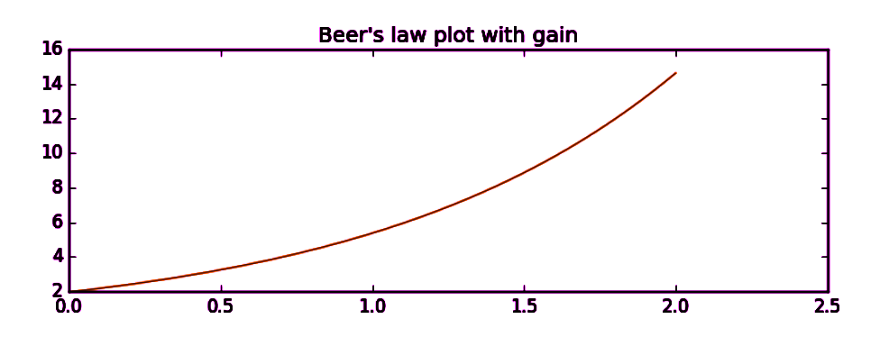
Light Propagation Through an Active Medium
However, if the medium generates light (e.g. due to stimulated emission) to enhance the intensity of propagating light. ( -α → g )
where I_{o} is the initial intensity, z is the distance and g is the gain coefficient.
Thus radiation increases its intensity upon traveling through a gain medium.
I = I_{o}exp(gz)
Intensity
Distance

Slide 6
Selected Methodology and Formulation
Extensive literature survey on relevant topics.
Studied different geometries like add-drop and all-pass ring resonator and their resonant behaviors.
Derived equations for transmission and reflection along with their respective phases for one, two and composite resonator systems.
Used Mathematica and Python to produce previously published results.
Introduced gain in optical resonators and studied their characteristics.

Slide 7
Studied literature
R. W. Boyd, D. D. Smith, H. Chang, K. A. Fuller, A. T. Rosenberger, “Coupled-resonator-induced transparency”, Phy. Rev. A 69, (2004).
A. Naweed, G. Farca, S. I. Shopova, and A. T. Rosenberger, “Induced transparency and absorption in coupled whispering-gallery microresonators”, Phy. Rev. A 71, (2005)
Bo Peng, S. Kaya, W. Chen, F. Nori, & L. Yang, “What is and what is not electromagnetically induced transparency in whispering-gallery microcavities”, 24 Oct 2014, ncomms6082.
Photonic Microresonator Research and Applications, Ioannis Chremmos · Otto Schwelb ·Nikolaos Uzunoglu, Springer Science+Business Media, LLC 2010

Slide 8
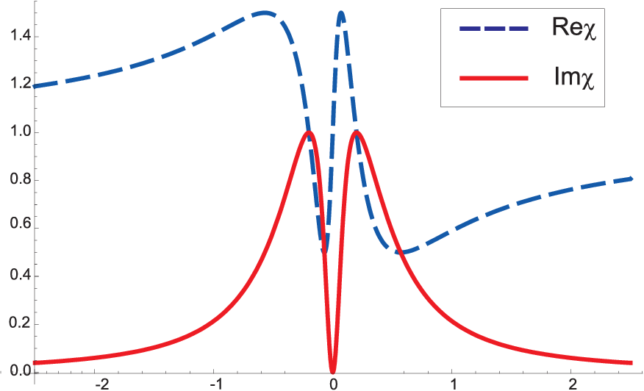
Electromagnetically Induced Transparency
Quantum interferences between atomic energy levels creates a narrow transparency window in the absorption spectrum by eliminating resonant absorption of light.
This phenomenon is known as Electromagnetically Induced Transparency (EIT).
Excited state
n
E_{a}
3
Probe
Control
2
Metastable state
1
Ground State

Slide 9
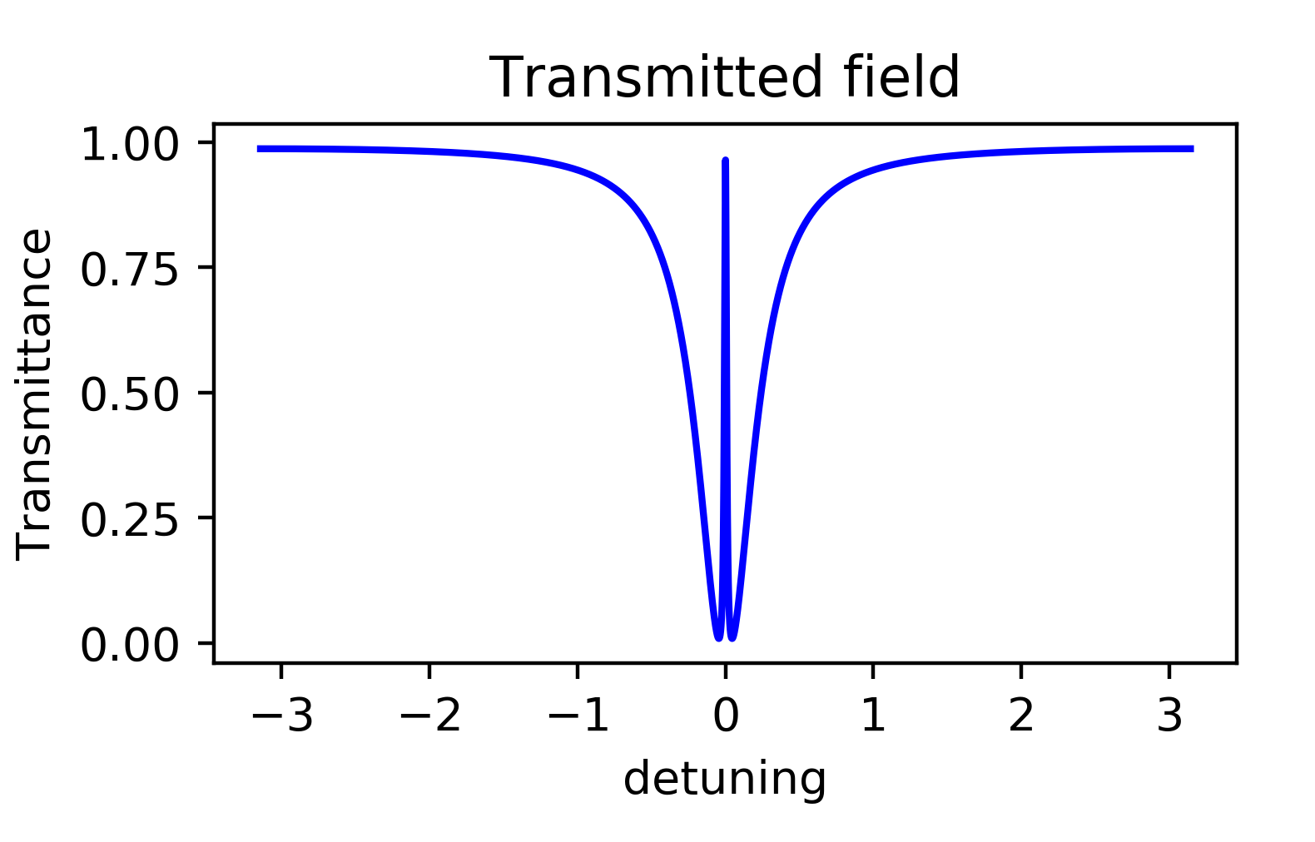
Coupled Resonator Induced Transparency
The optical analog of EIT is called Coupled Resonator Induced Transparency (CRIT)
Alternatively, EIT maybe achieved by coupling two ring resonators
2
High Q
r₂
Low Q
1
E_{i}
E_{t}
r₁

Slide 10
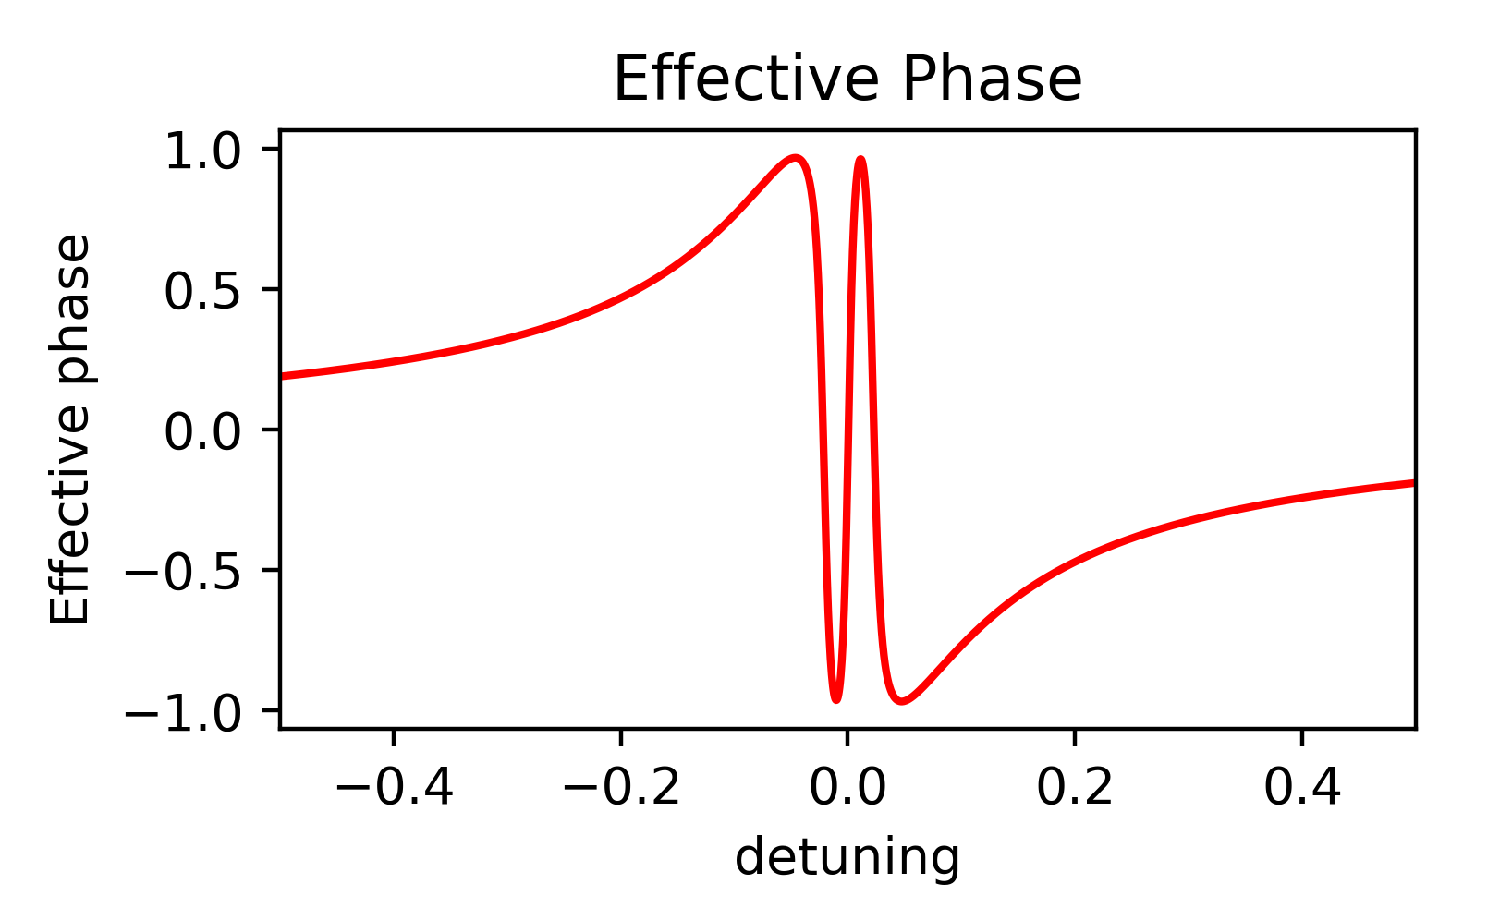
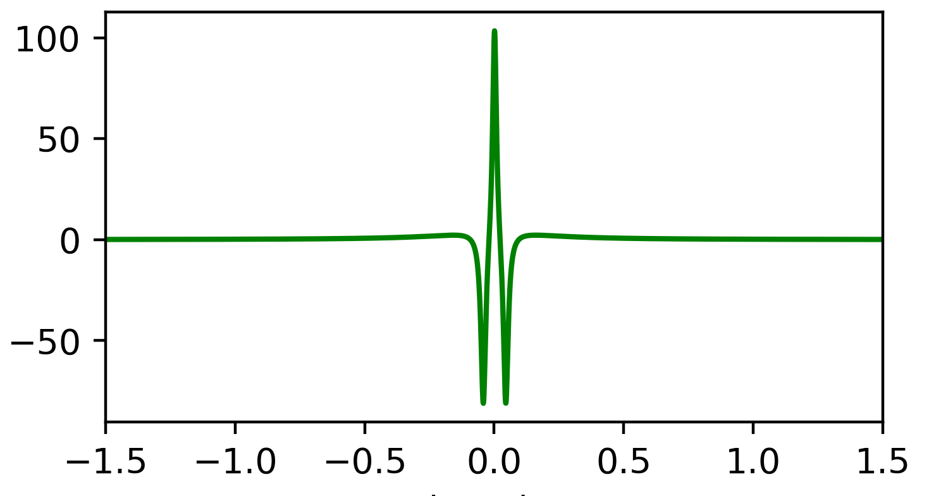
Dispersion And Group Index
Remarkably, CRIT also displays similar spectral and dispersive properties to EIT which leads to ultra slow group velocities (e.g. 8ms⁻¹) and high photon storage time
EIT always gives slow light in passive resonators
Group Index
R. W. Boyd, D. D. Smith, H. Chang, K. A. Fuller, A. T. Rosenberger, “Coupled-resonator-induced transparency”, Phy. Rev. A 69, (2004).

Slide 11
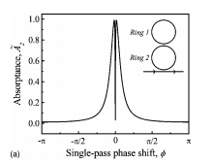
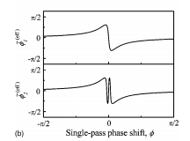
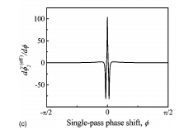
Reproduced Results
R. W. Boyd, D. D. Smith, H. Chang, K. A. Fuller, A. T. Rosenberger, “Coupled-resonator-induced transparency”, Phy. Rev. A 69, (2004).

Slide 12
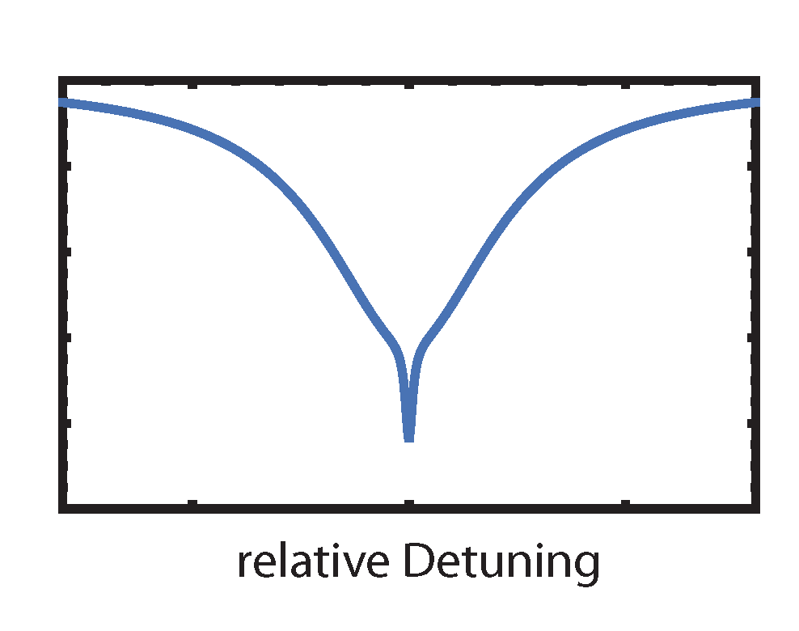
Electromagnetically Induced Absorption
A similar phenomenon in which quantum interferences between energy levels causes a dip in the transmission spectrum is called Electromagnetically Induced Absorption (EIA).
Coupled resonators also displays EIA-like effects which is called Coupled Resonator Induced Absorption (CRIA).
EIA in passive resonators can give both fast and slow light.
Transmission
Frequency Detuning

Slide 13
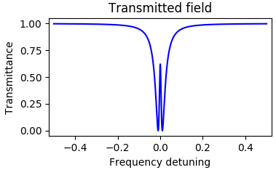
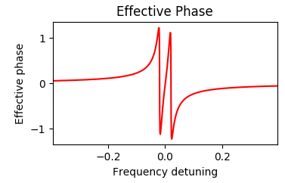
Results
Passive two resonator system
Coupled Resonator Induced Transparency (CRIT) is observed in a passive two resonator system.
2
r₂
1
E_{i}
E_{t}
r₁

Slide 14
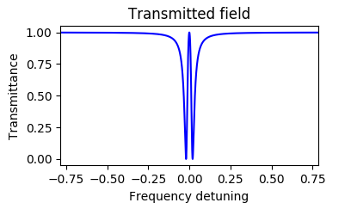
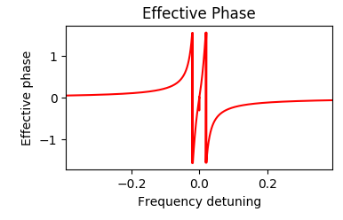
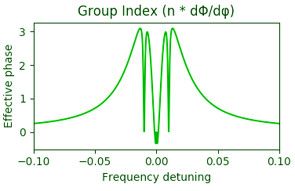
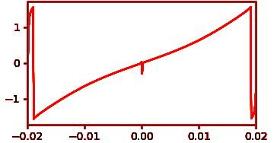
Introducing gain in resonator 2
Now we increase gain in the second resonator such that g₂ < α₂
The peak of the EIT rises to 1 when g₂ → α₂
The Effective phase becomes anomalous!
2
1

Slide 15
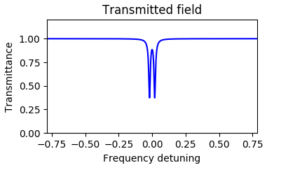
Activating gain in resonator 1
Now we increase the gain in first resonator such that g₁ < α₁
The spectrum starts to rise up and displays hanging EIT.
The phase is shown on the right.
2
1

Slide 16
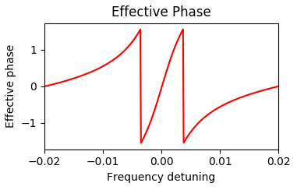
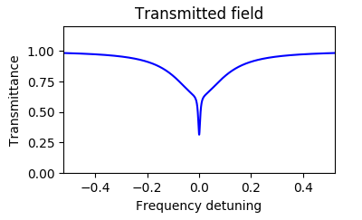
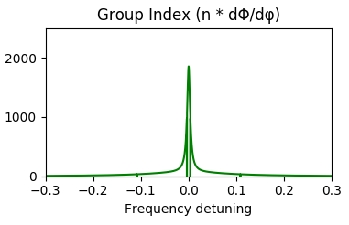
Passive two resonator system
Electromagnetically Induced Absorption is observed in a passive system.
2
1
This EIA produces slow light

Slide 17
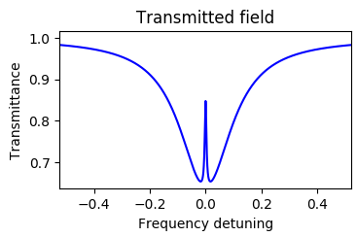
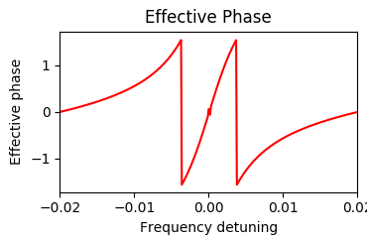
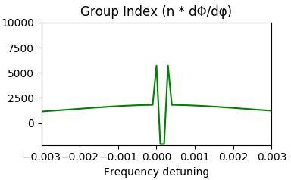
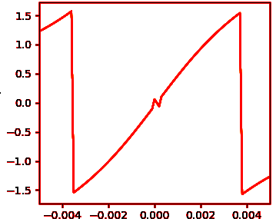
Activating gain in resonator 2
Now we activate gain in the second resonator such that g₂ < α₂ . When the gain is closer to the value of α₁ ( g₂ → α₂) makes the EIA change into EIT type transmission
2
1
Here we see anomalous dispersion i.e fast light!

Slide 18
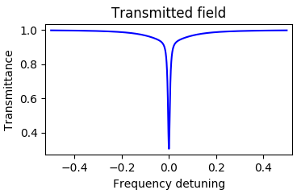
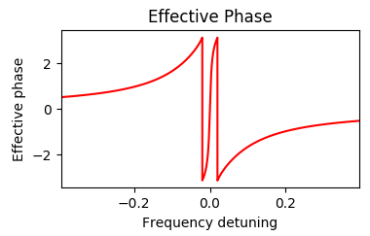
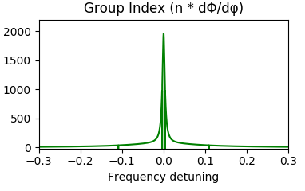
Activating gain in resonator 1
Now we increase the gain in first resonator such that g₁ < α₁
The peak starts to narrow down and we see normal dispersion
The phase is shown on the right
2
1

Slide 19
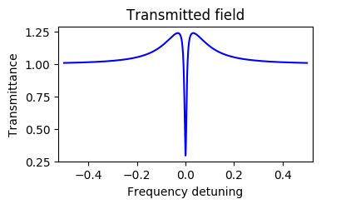
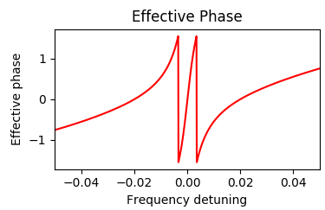
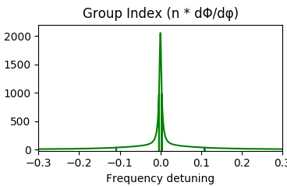
Increasing gain in resonator 1
Further increase the gain in first resonator such that g₁ > α₁
Two off resonance peaks starts to appear along with absorption dip
The phase is shown on the right

Slide 20
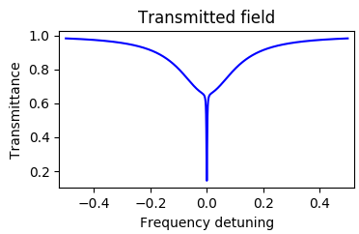
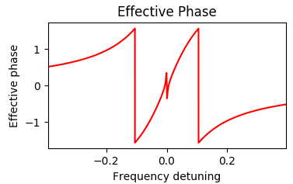
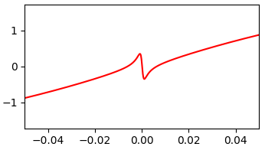
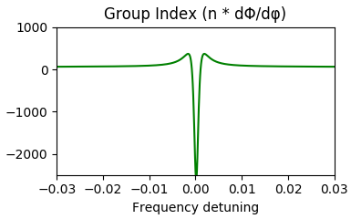
CRIA with Fast light
CRIA in coupled resonators can also provide us fast light

Slide 21
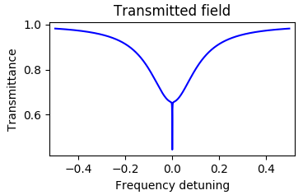
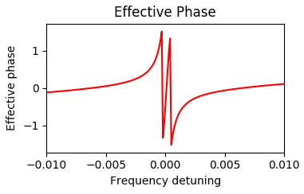
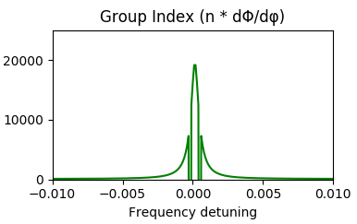
Activating gain in resonator 2
Now we increase gain in the second resonator such that g₂ < α₂
The transmission dip narrows down when g₂ → α₂
We see transition from fast light to slow light!
2
1

Slide 22
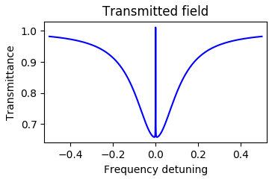
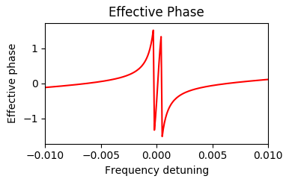
Increasing gain in resonator 2
The transmission dip narrows changes to EIT peak when g₂ > α₂
We again see slow light in EIT!

Slide 23
Summary
We studied different relations for transmission and reflection for ring resonator systems and their respective phases.
We observed EIT and EIA like phenomenon in these coupled resonator systems.
We reproduced results of original work on CRIT.
We introduced gain in these resonators and found dramatic changes in transmission and dispersion spectrum.
We introduced gain in two resonator system by first activating gain in resonator 1 and then in resonator 2.
We see that activating gain differently produces different results.
R. W. Boyd Coupled-Resonator-Induced Transparency, Physical Review A 69(6) · February 2003

Slide 24
Conclusion
We have observed from these results, the optical properties varies drastically from passive and active resonators.
Activating gain in the medium enables us to transit between slow and fast light with little effort which is hard to achieve otherwise in a passive resonator systems.
Active resonators (i.e with gain) are useful to control resonator-wave guide coupling regimes and photon storage time in resonators.

Slide 25
THANK YOU
FOR YOUR ATTENTION

Slide 26
ANY QUESTIONS?

Slide 27
CRIT Values
r₁ = 0.9889 and r₂ = 0.9998.
a₁ = 0.9911 and a₂ = 0.9991
CRIA Values
r₁ = 0.8999 and r₂ = 0.9998.
a₁ = 0.995 and a₂ = 0.9995

